Slide 1
The F - Distribution

Slide 2
The F Distribution
Named in honor of R.A. Fisher who studied it in 1924.
Used for comparing the variances of two populations.
It is defined in terms of ratio of the variances of two normally distributed populations. So, it
sometimes also called variance ratio.
F–distribution: where
_{s} 2 _{σ} 2
1 1
s₂ σ ₂
2 2

Slide 3
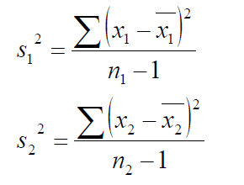
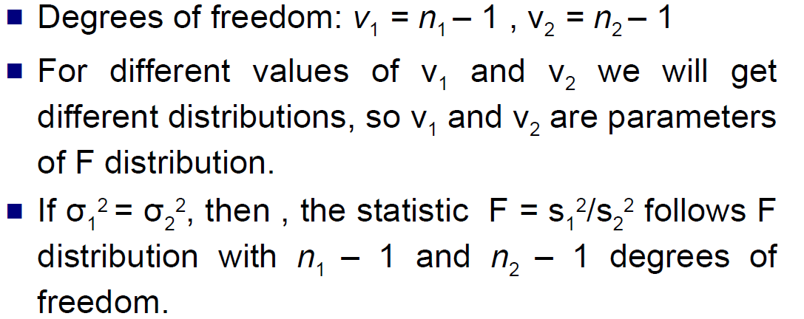

Slide 4
Probability density function
Probability density function of F-distribution:
f ( F ) = Y
^{F}υ 2−1
o ⎡
υ ⎤ ₍
1
1+
1
υ +υ ) 2
⎢
⎥ 1 2
υ
⎣ 2 ⎦
where Y₀ is a constant depending on the values of v₁ and v₂ such that the area under the curve is unity.

Slide 5
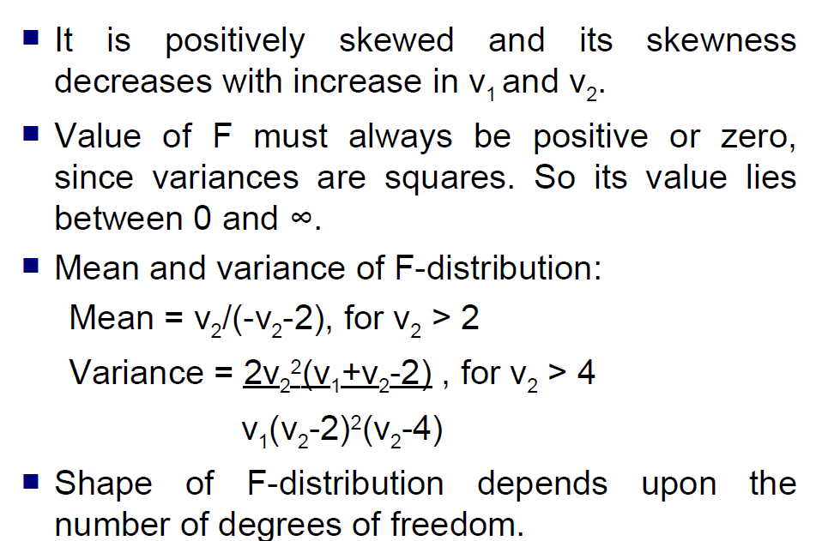
Properties of F-distribution

Slide 6
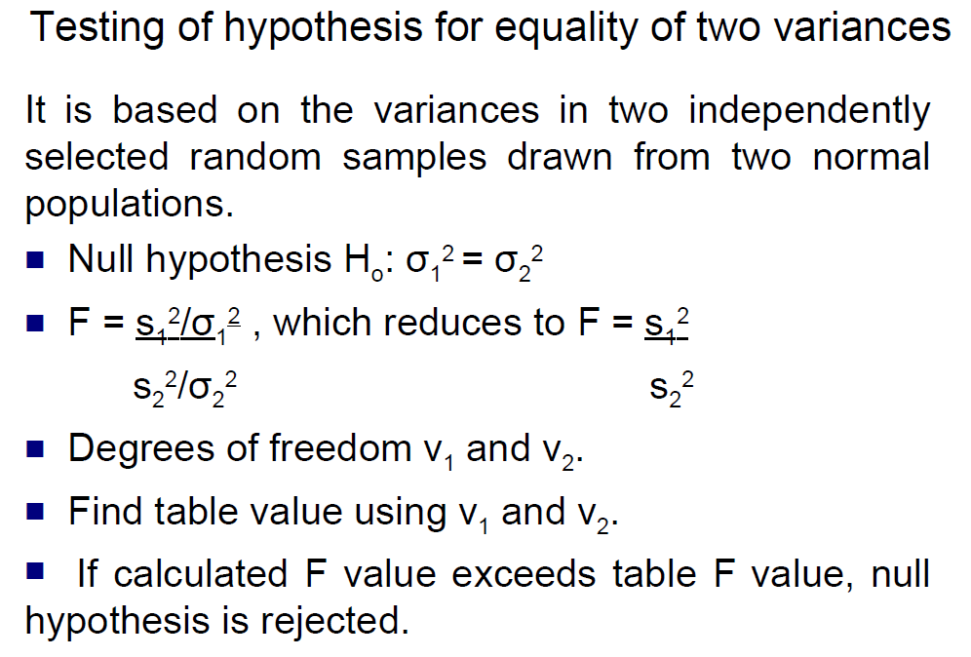

Slide 7
Assumptions of F-Distribution
Assumes both populations are normally distributed.
Both populations are independent of each other.
The larger sample variance always goes in the numerator to make the right-tailed test, and the right-tailed tests are always easy to calculate.

Slide 8
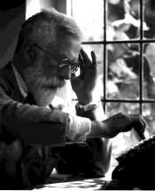
ANALYSIS OF VARIANCE (ANOVA)

Slide 9
CONTENTS
1.Introduction 2.F-Statistics
Technique of analysing variance 4.Classification of analysis of variance
One-way classification
Two-way classification 5.Applications of analysis of variance

Slide 10
INTRODUCTION
The analysis of variance(ANOVA) is developed by
R.A.Fisher in 1920.
If the number of samples is more than two the Z-test and t-test cannot be used.
The technique of variance analysis developed by fisher is very useful in such cases and with its help it is possible to study the significance of the difference of mean values of a large no.of samples at the same time.
The techniques of variance analysis originated, in agricultural research where the effect of various types of soils on the output or the effect of different types of fertilizers on production had to be studied.

Slide 11
The technique of the analysis of variance was extremely useful in all types of researches.
The variance analysis studies the significance of the difference in means by analysing variance.
The variances would differ only when the means are
significantly different.
The technique of the analysis of variance as developed by Fisher is capable of fruitful application in a variety of problems.
H₀: Variability w/i groups = variability b/t groups, this means that ₁ = _{n}
H_{a}: Variability w/i groups does not = variability b/t groups, or, ₁ ≠ _{n}

Slide 12
F-STATISTICS
ANOVA measures two sources of variation in the data
and compares their relative sizes.
variation BETWEEN groups:
for each data value look at the difference between
its group mean and the overall mean.
variation WITHIN groups :
for each data value we look at the difference between that value and the mean of its group.

Slide 13

The ANOVA F-statistic is a ratio of the Between Group Variaton divided by the Within Group Variation:
F=
A large F is evidence against H₀, since it indicates that there is more difference between groups than within groups.

Slide 14
TECNIQUE OF ANALYSING VARIANCE
The technique of analysing the variance in case of a single variable and in case two variables is similar.
In both cases a comparison is made between the variance
of sample means with the residual variance.
However, in case of a single variable, the total variance is divided in two parts only, viz..,
variance between the samples and variance within the
samples.
The latter variance is the residual variance. In case of two variables the total variance is divided in three parts, viz.
Variance due to variable no.1
Variance due to variable no.2
Residual variance.

Slide 15
CLASSIFICATION OF ANOVA
The Analysis of variance is classified into two ways:
One-way classification
Two-way classification

Slide 16
ONE-WAY CLASSIFICATION
In one-way classification we take into account only one variable- say, the effect of different types of fertilizers on yield.
Other factors like difference in soil fertility or the availability of irrigation facilities etc. are not considered.
For one-way classification we may conduct the experiment through a number of sample studies.
Thus, if four different fertilizers are being studied we may have four samples of, say, 10 fields each and conduct the experiment.
We will note down the yield on each one of the field of various samples and then with help of F-test try to find out if there is a significant difference in the mean yields given by different fertilizers.

Slide 17
 |  | Treatments
 |  | 1 | 2 | 3
 | 1 | ^{X}11 | ^{X}12 | ^{X}13
Replicants | 2 | ^{X}21 | ^{X}22 | ^{X}23
 | 3 | ^{X}31 | ^{X}32 | ^{X}33
 | Total | ∑x_{C1} | ∑x_{C2} | ∑x_{C3}
a.We will start with the Null Hypothesis that is, the mean yield of the four fertilizers is not different in the universe, or
H₀: µ₁ = µ₂ = µ₃ = µ₄
The alternate hypothesis will be H₀: µ₁ ≠ µ₂ ≠ µ₃ ≠ µ₄

Slide 18
b. Compute grad total, G=∑x_{C1}+∑x_{C2}+∑x_{C3} Correction factor(C.F)= G² ̸N—D
Total sum of samples(SST)=A-D SST=∑x_{C1 +}∑x_{C2 +}∑x_{C3 −} G
2 2 2 2
Sum of squares between samples(colums) SSC=B-D
SSC=(∑x_{C1 )}² ̸ n_{c1} +(∑x_{C2 )}² ̸ n_{c2} + ∑x_{C3 )}² ̸ n_{c3} - G² ̸N
Where n_{c1} = no. of elements in first column etc.
Sum of squares with in samples, SSE=SST-SSC SSE=A-D-(B-D)=A-B

Slide 19
f. The no.of d.f for between samples, ᶹ₁ =C-1
The no.of d.f for Within the samples,ᶹ₂ =N-C
Mean squares between columns,MSC=SSC̸ ᶹ₁= SSCC̸ -1
Mean squares within samples,
MSE=SSE̸ᶹ₂=SSEN-̸ C
F=MSC̸MSE if MSC>MSE or
MSE̸MSC if MSE>MSC
j. Conclusion: F_{cal}
< ^{F}tab
₌ accept H₀

Slide 20
Source of variance | d.f | Sum of squares | Mean sum of squares | F-Ratio
Between samples(columns) | ᶹ₁ =C-1 | SSC=B-D | MSC=SSCᶹ̸ ₁
Within samples(Residual) | ᶹ₂ =N-C | SSE=A-B | MSE=SSEᶹ̸ ₂ | F=MSCMSE
Total | N-1 | SST=A-D

Slide 21
TWO WAY CLASSIFICATION
In a one-way classification we take into account the effect of only one variable.
If there is a two way classification the effect of two variables can be studied.
The procedure' of analysis in a two-way classification is total both the columns and rows.
The effect of one factor is studied through the column wise figures and total's and of the other through the row wise figures and totals.
The variances are calculated for both the columns and rows and they are compared with the residual variance or error.

Slide 22
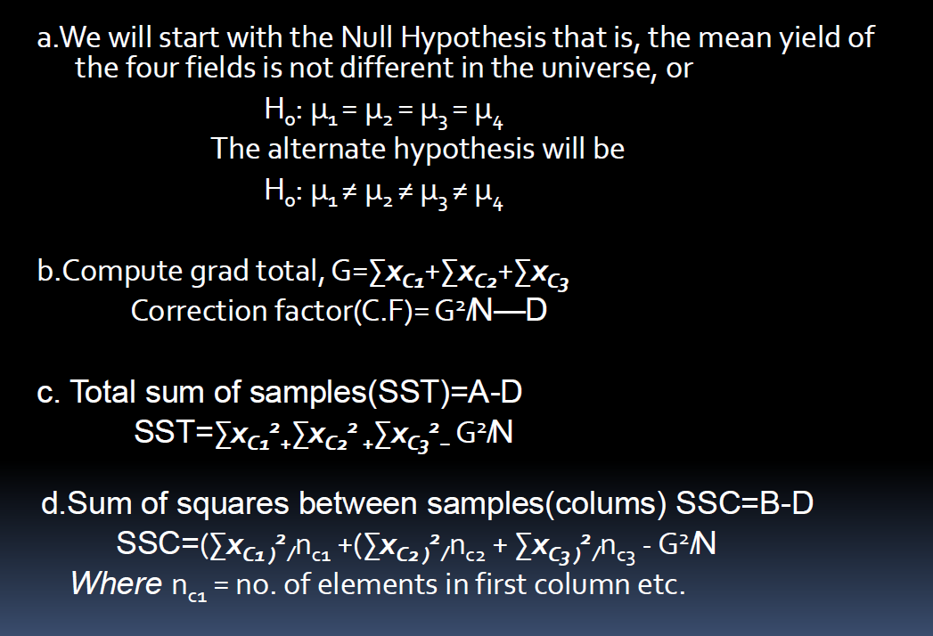

Slide 23
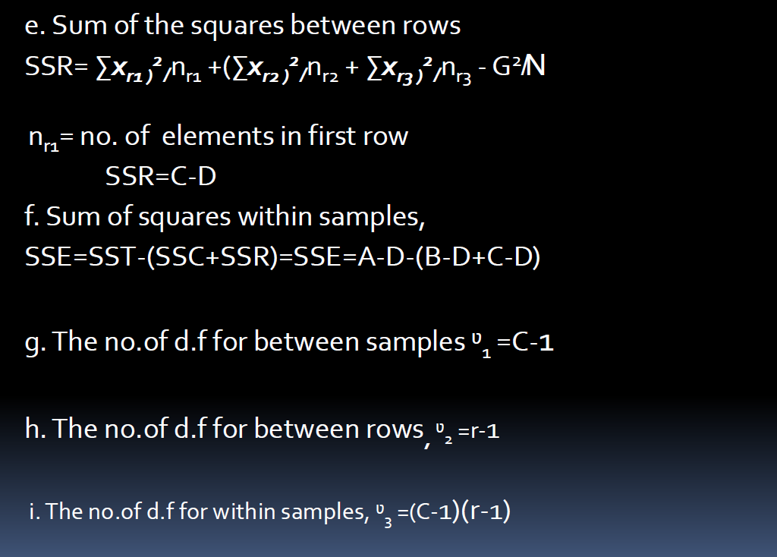

Slide 24
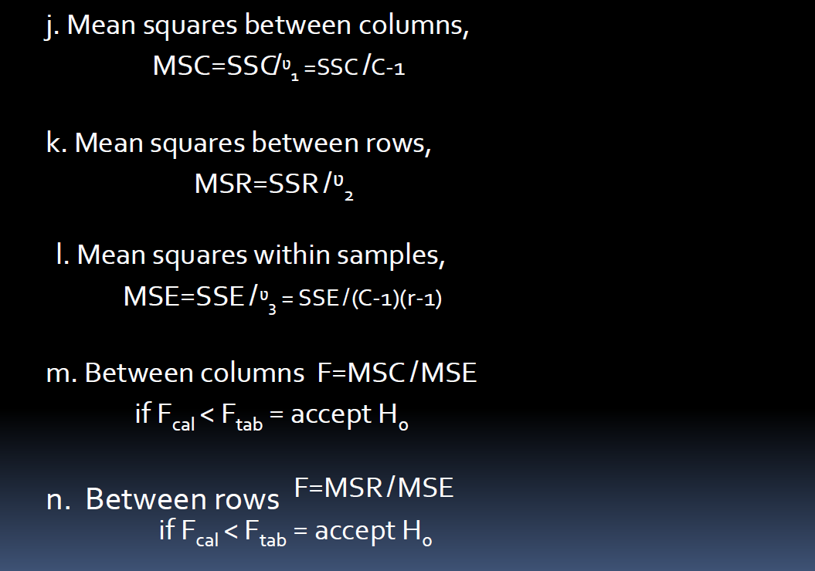

Slide 25
ANOVA TABLE FOR TWO-WAY
Source of variance | d.f | Sum of squares | Mean sum of squares | F-Ratio
Between samples(columns) | ᶹ₁ =C-1 | SSC=B-D | MSC=SSC ̸ ᶹ₁ | F=MSC ̸ MSE
Between Replicants(rows) | ᶹ₂ =r-1 | SSR=C-D | MSR=SSR ̸ ᶹ₂
Within samples(Residual) | ᶹ₃ =(c-1)(r-1) | SSE=SST- (SSC+SSR) | MSE=SSE ̸ ᶹ₃ | F=MSR ̸ MSE
Total | n-1 | SST=A-D

Slide 26
APPLICATIONS OF ANOVA
Similar to t-test
More versatile than t-test
ANOVA is the synthesis of several ideas & it is used for multiple purposes.
The statistical Analysis depends on the design and discussion of ANOVA therefore includes common statistical designs used in pharmaceutical research.

Slide 27
This is particularly applicable to experiment otherwise difficult to implement such as is the case in Clinical trials.
In the bioequelence studies the similarities between the
samples will be analyzed with ANOVA only.
Pharmacokinetic data also will be evaluated using ANOVA.
Pharmacodynamics (what drugs does to the body) data also will be analyzed with ANOVA only.
That means we can analyze our drug is showing significant pharmacological action (or) not.

Slide 28
Compare heights of plants with and without galls.
Compare birth weights of deer in different geographical regions.
Compare responses of patients to real medication vs.
placebo.
Compare attention spans of undergraduate students in different programs at PC.

Slide 29
General Applications:
Pharmacy
Biology
Microbiology
Agriculture
Statistics
Marketing
Business research
Finance
Mechanical calculations

